Slide 1


COMPUTER NETWORKS
24CS2202
Topic:
ENCODING TECHNIQUES
Session - 7

Slide 2



AIM OF THE SESSION
To understand the concept, types, and applications of Line Encoding Techniques used for digital data transmission, and to analyze the advantages and disadvantages of each encoding method.
INSTRUCTIONAL OBJECTIVES
This Session is designed to:
To understand and explain the principles and types of line encoding techniques used in digital communication.
To apply and compare different line encoding methods for effective data transmission and synchronization.
LEARNING OUTCOMES
At the end of this session, you should be able to:
Identify and describe various encoding techniques used in digital communication, such as NRZ, Manchester, and AMI.
Differentiate between encoding schemes based on their characteristics like bandwidth, synchronization, and error detection.
Illustrate the signal waveform for a given binary data using appropriate encoding methods.

Slide 3
DIGITAL-TO-DIGITAL CONVERSION
Data element: It is the smallest entity that can represent a piece of information: this is the
bit. In digital data communications, a signal element carries data elements.
Signal element: It is the shortest unit (time-wise) of a digital signal.
In other words, data elements are what we need to send; signal elements are what we can send. Data elements are being carried; signal elements are the carriers
Data Rate and Signal Rate
The data rate defines the number of data elements (bits) sent in Is. The unit is bits per second (bps). The data rate is sometimes called the bit rate
The signal rate is the number of signal elements sent in Is. The unit is the baud. The signal rate is sometimes called the pulse rate, the modulation rate, or the baud rate.

Slide 4
DIGITAL-TO-DIGITAL CONVERSION
How we can represent digital data by using digital signals?
The conversion involves three techniques:
line coding
block coding
scrambling
Line coding is always needed; block coding and scrambling may or may not be needed.

Slide 5
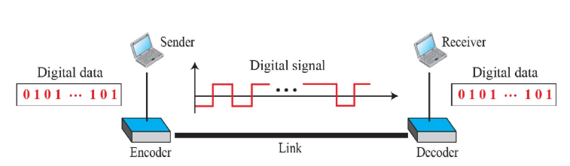
Line Coding
Line Coding
Line coding is the process of converting digital data to digital signals.
We assume that data, in the form of text, numbers, graphical images, audio, or video, are stored in computer memory as sequences of bits.
Line coding converts a sequence of bits to a digital signal.
At the sender, digital data are encoded into a digital signal; at the receiver, the digital data are recreated by decoding the digital signal.

Slide 6
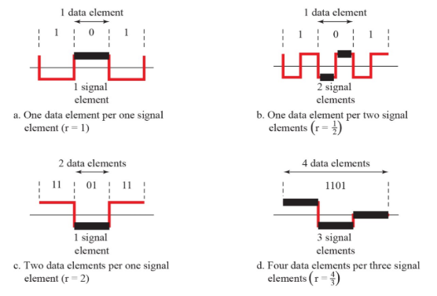
SIGNAL ELEMENTS VS DATA ELEMENTS

Slide 7
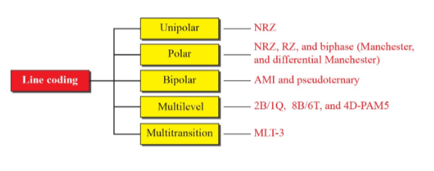
Line Coding Schemes
Line Coding Schemes
We can roughly divide line coding schemes into five broad categories.
There are several schemes in each category.

Slide 8
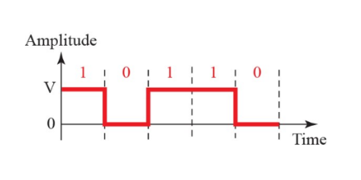
UNIPOLAR NRZ
Unipolar NRZ
In a unipolar scheme, all the signal levels are on one side of the time axis, either above or below.
NRZ (Non-Return-to-Zero) Traditionally, a unipolar scheme was designed as a non-return-to-zero (NRZ) scheme in which the positive voltage defines bit I and the zero voltage defines bit O.
It is called NRZ because the signal does not return to zero at
the middle of the bit.

Slide 9
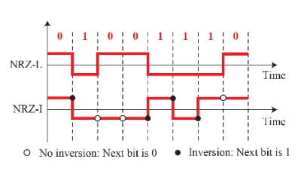
POLAR NRZ
Polar NRZ
In polar schemes, the voltages are on the both sides of the time axis. For example, the voltage level for 0 can be positive and the voltage level for I can be negative.
Non-Return-to-Zero (NRZ) In polar NRZ encoding, we use two levels of voltage amplitude. We can have two versions of polar NRZ: NRZ-Land NRZ-I. In the first variation, NRZ-L (NRZ-Level), the level of the voltage determines the value of the bit. In the second variation, NRZ-I (NRZ-Invert), the change or lack of change in the level of the voltage determines the value of the bit.
If there is no change, the bit is 0; if there is a change, the bit is 1.

Slide 10
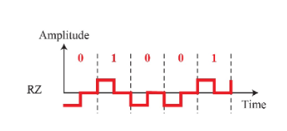
POLAR RZ
Polar RZ
The main problem with NRZ encoding occurs when the sender and receiver clocks are not synchronized. The receiver does not know when one bit has
ended and the next bit is starting.
One solution is the return-to-zero (RZ) scheme,
which uses three values: positive, negative, and zero.
In RZ, the signal changes not between bits but during the bit. In Figure we see that the signal goes to 0 in the middle of each bit. It remains there until the beginning of the next bit.

Slide 11
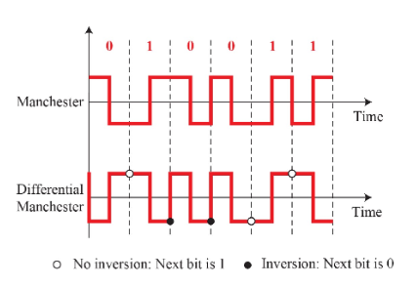
POLAR Biphase
Polar Biphase
Biphase: Manchester and Differential Manchester
The idea of RZ (transition at the middle of the bit) and the idea of NRZ-L are combined into the Manchester scheme.
In Manchester encoding, the duration of the bit is divided into two halves. The voltage
remains at one level during the first half and moves to the other level in the second half.
The transition at the middle of the bit provides synchronization.
Differential Manchester, on the other hand, combines the ideas of RZ and NRZ-I. There is always a transition at the middle of the bit, but the bit values are determined at the beginning of the bit.
If the next bit is 0, there is a transition; if the next bit is 1, there is none.

Slide 12
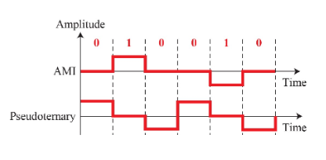
Bipolar
Bipolar encoding (sometimes called multilevel binary)
There are three voltage levels: positive, negative, and zero.
The voltage level for one data element is at zero, while the voltage level for the other element alternates between positive and negative.
AMI and Pseudoternary
Bipolar alternate mark inversion (AMI).
In the term alternate mark inversion, the word mark comes
from telegraphy and means 1.
So AMI means alternate I inversion.
A neutral zero voltage represents binary 0.
Binary I’s are represented by alternating positive and negative
voltages.
Pseudoternary
the 1 bit is encoded as a zero voltage and the 0 bit is encoded as alternating positive and negative voltages.

Slide 13
SELF-ASSESSMENT QUESTIONS
Which of the following is a characteristic of Non-Return-to-Zero (NRZ) encoding?
Uses three voltage levels
Has a transition at the middle of each bit
Maintains constant voltage for the entire bit duration
Is self-clocking
Which encoding technique ensures synchronization by making a transition in the middle of each bit?
NRZ-Level
Manchester
NRZ-Inverted
Unipolar NRZ
3. In NRZ-Inverted (NRZI) encoding, a transition at the beginning of the bit interval indicates:
A '0' bit
A '1' bit
No data
Synchronization signal

Slide 14

Topic Summary
Encoding Techniques
  Unipolar
  NRZ
  Polar
  NRZ, RZ, Biphase
  Bipolar
  AMI, Pseudoternary

Slide 15
REFERENCES FOR FURTHER LEARNING OF THE SESSION
Reference Books:
Behrouz A. Forouzan , “Data Communication and Networking”, TMH, 6th Edition ,(2012).
A.S. Tanenbaum, David J. Wetheral “Computer Networks” Pearson, 5th Edition.
Kurose, J and Ross, K Computer Networking: A Top-Down Approach Addison-Wesley- 6th edition.
Sites and Web links:
https://www.geeksforgeeks.org/types-of-transmission-technology/
https://www.tutorialspoint.com/data_communication_computer_network/computer_network_topologies.htm
3. https://www.javatpoint.com/computer-network-transmission-modes

Slide 16
THANK YOU
Team – Computer Networks

